Slide 1

selecting a fast-food outlet location using data analysis
Photo by Andrea Piacquadio from Pexels

Slide 2
This presentation outlines the process of selecting a location of a fast-food franchise at Hibiscus and Bays area, Albany Ward, Auckland, New Zealand using Foursquare and other relevant location and demographic data.

Slide 3
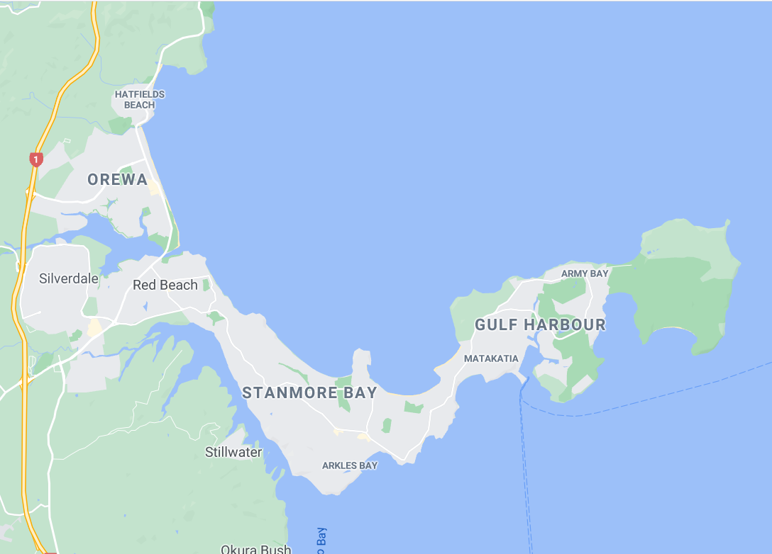
WHERE SHOULD I BUILD MY FAST FOOD OUTLET AT HIBISCUS COAST?
Mapdata at 2020 by Google

Slide 4

WHAT FACTORS SHOULD I CONSIDER?
ACCESSIBILITY
DEMOGRAPHICS
SECURITY
VISIBILITY
PARKING
COMPETITORS
Photo by Andrea Piacquadio from Pexels

Slide 5

LET US FIGURE THIS OUT TOGETHER USING DATA ANALYSIS
Photo by Gustavo Fring from Pexels

Slide 6

FIRST THINGS FIRST
TALL,DARK,HANDSOME,FUNNY, SMART
Identify who your customers are through the fast-food franchise advertisements
Sorry wrong list!!!
Based on advertisements my target customers are:
YOUTH AND YOUNG
ADULTS
LOW TO AVERAGE
INCOME INDIVIDUALS
Photo by cottonbro from Pexels

Slide 7

SHORTLIST YOUR TARGET AREAS: BASED ON THE ABSENCE OF FRANCHISE OUTLET
Orewa
Gulf Harbour
Stanmore Bay
Silverdale
Silverdale suburb is removed from the list because there is an existing franchise outlet in the area
Mapdata at 2020 by Google
Photo by Andrea Piacquadio from Pexels

Slide 8

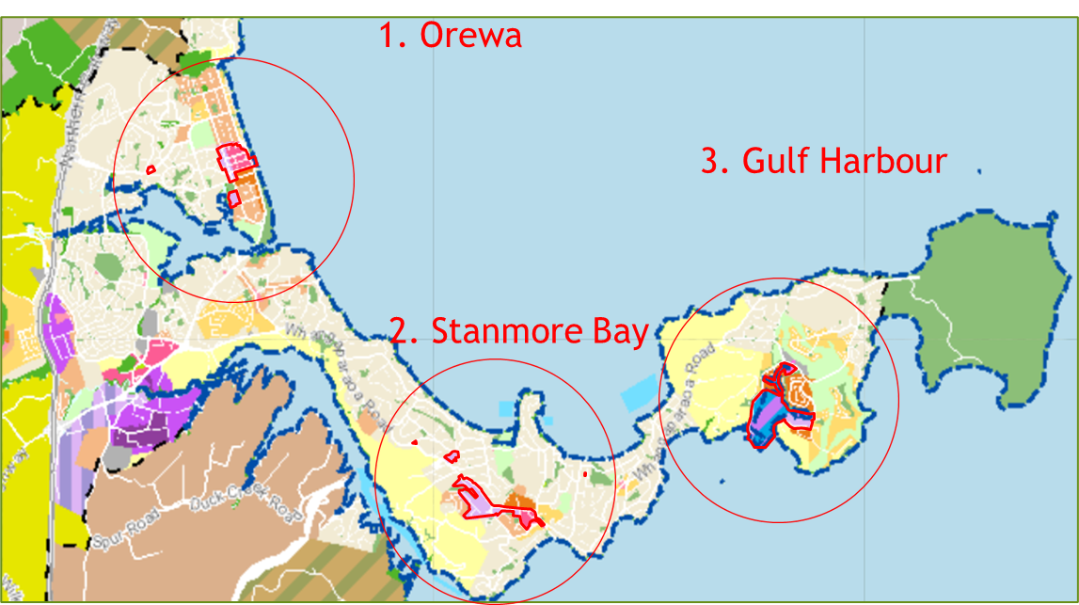
SHORTLIST YOUR TARGET AREAS: BASED ON COUNCIL ZONING REQUIREMENTS
Areas zoned for commercial activities are highlighted in red
Mapdata at unitaryplanmaps by Auckland Council
Photo by Andrea Piacquadio from Pexels

Slide 9

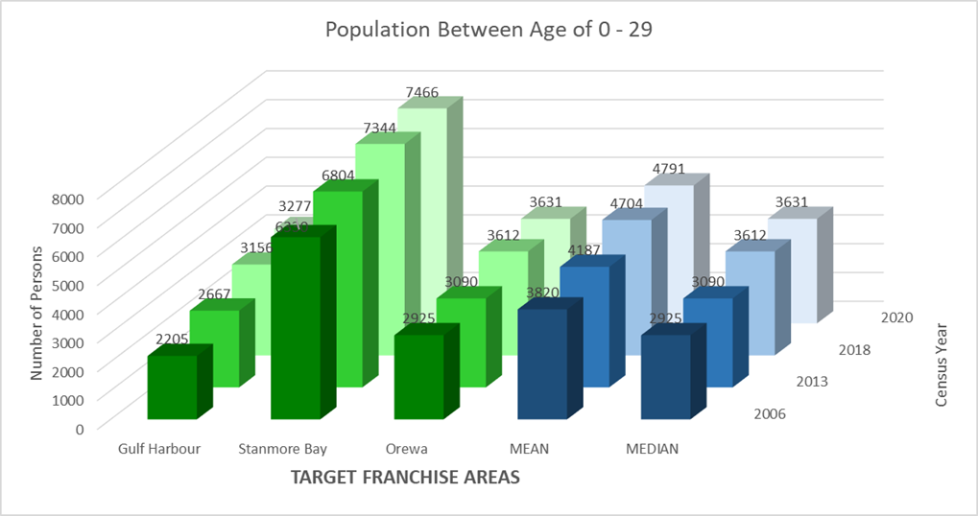
TARGET DEMOGRAPHICS: YOUTH AND YOUNG ADULTS
Stanmore bay suburb has the greatest number of residents between age of 0-29 among the three areas.
Photo by Agung Pandit Wiguna from Pexels

Slide 10
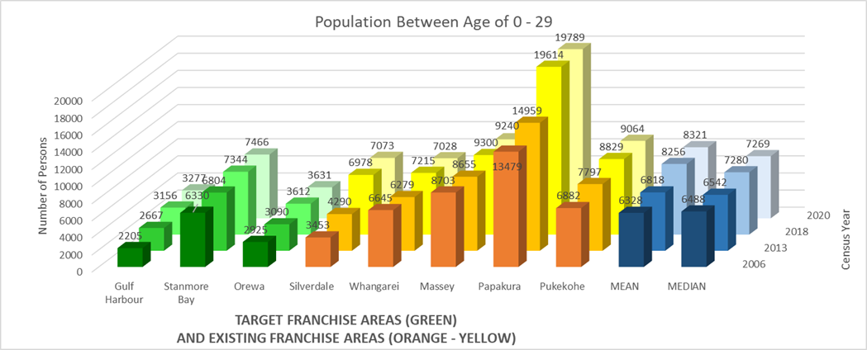
TARGET DEMOGRAPHICS: YOUTH AND YOUNG ADULTS
Stanmore bay suburb has around the median number target demographics according to age compared with the similar markets.
Photo by Agung Pandit Wiguna from Pexels

Slide 11

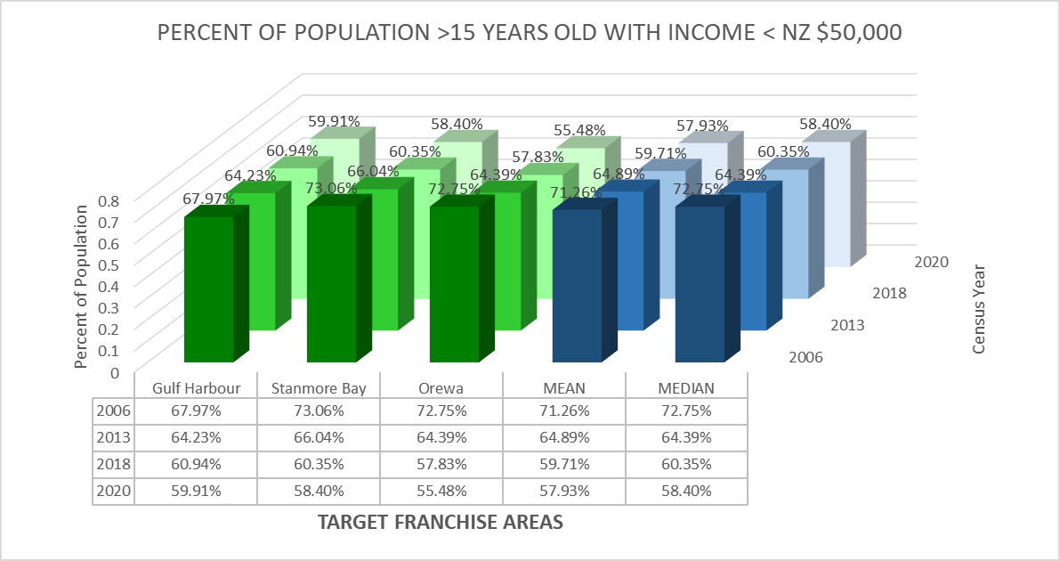
TARGET DEMOGRAPHICS: LOW TO MIDDLE INCOME BRACKET
Target population according to income are shown to decrease across the board.
Photo by Moose Photos from Pexels

Slide 12
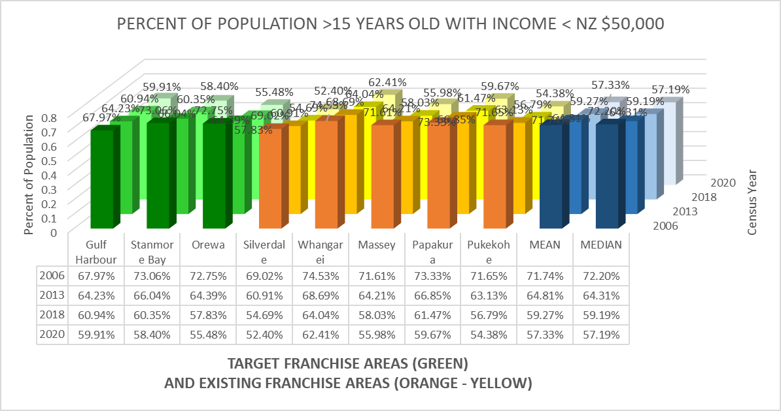
TARGET DEMOGRAPHICS: LOW TO MIDDLE INCOME BRACKET
Target population according to income have decreased even with existing markets.
Photo by Moose Photos from Pexels

Slide 13

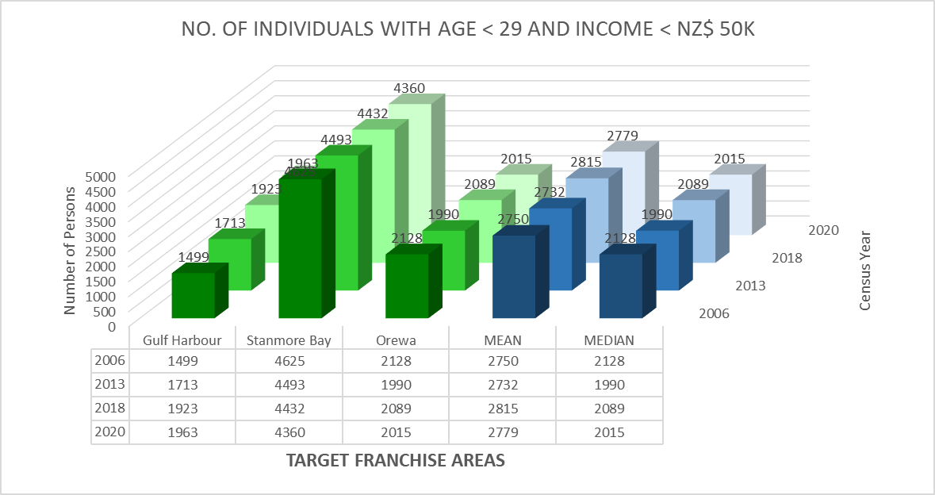
TARGET DEMOGRAPHICS: COMBINED AGE AND INCOME
Stanmore bay suburb has the greatest number of target demographic for both age and income among the three areas.
Photo by fauxels from Pexels

Slide 14
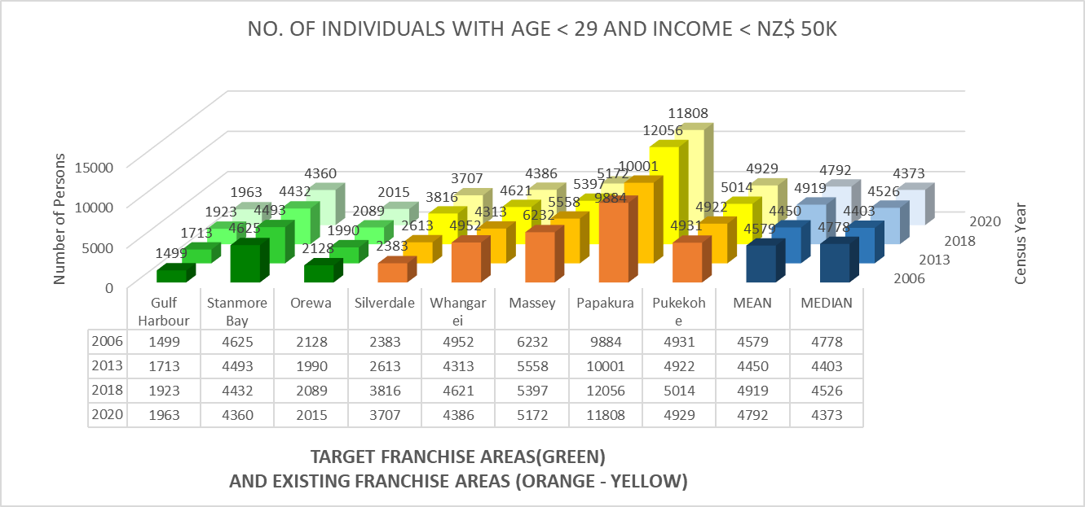
TARGET DEMOGRAPHICS: COMBINED AGE AND INCOME
Stanmore bay suburb has around the median number of target demographic for both age and income for areas that include existing markets.
Photo by fauxels from Pexels

Slide 15
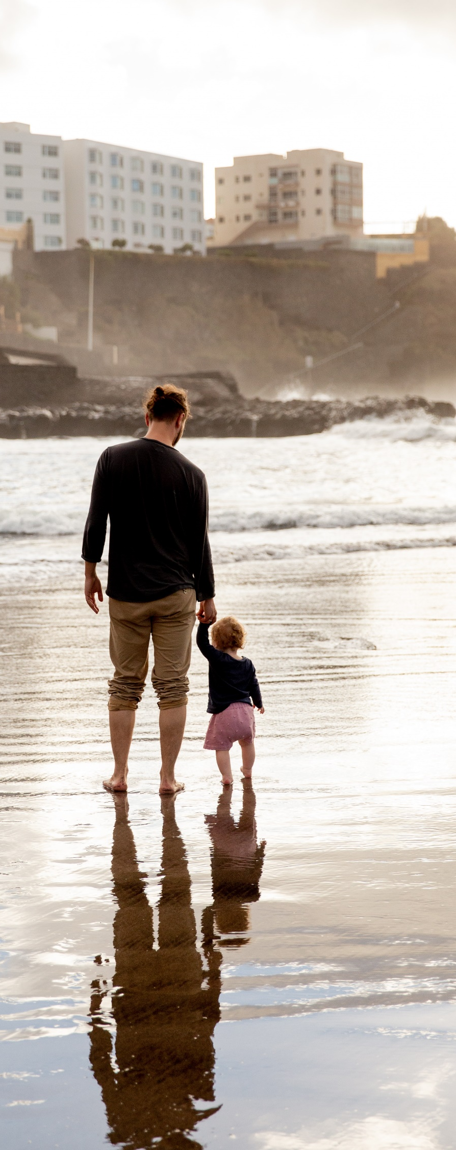
OREWA: EFFECT OF GEOGRAPHY
Orewa
Gulf Harbour
Stanmore Bay
Silverdale
If Orewa is the selected area, half of the target demographic at both Gulf Harbour and Stanmore Bay is assumed to go to Orewa and the other half to Silverdale.
Mapdata at 2020 by Google
Photo by Tatiana Syrikova from Pexels

Slide 16
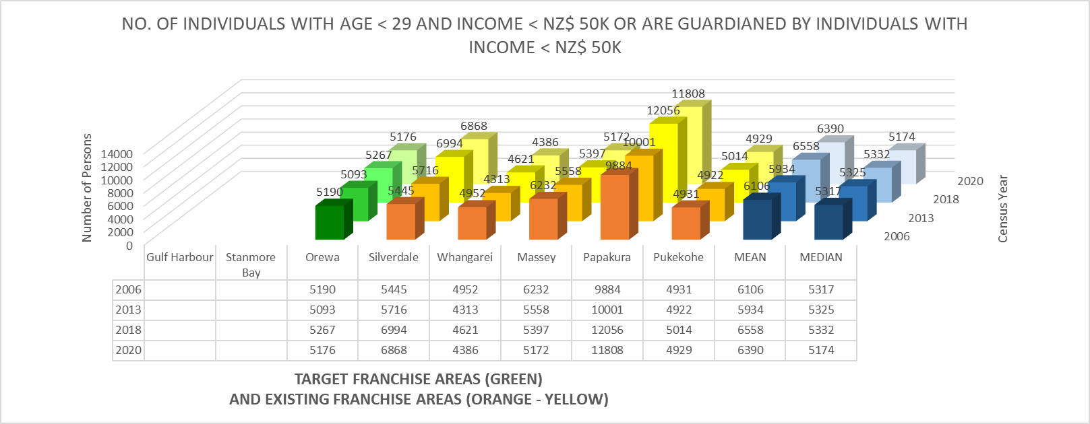
OREWA: EFFECT OF GEOGRAPHY
This is shown to increase the target demographics of Orewa to around the median of comparable target markets.
Photo by Tatiana Syrikova from Pexels

Slide 17
STANMORE BAY: EFFECT OF GEOGRAPHY
Orewa
Gulf Harbour
Stanmore Bay
Silverdale
If Stanmore Bay is the selected area, the target demographics at Gulf Harbour is expected to patronize Stanmore Bay due to proximity. Those at Orewa will continue to patronize the outlet at Silverdale.
Mapdata at 2020 by Google
Photo by Tatiana Syrikova from Pexels

Slide 18
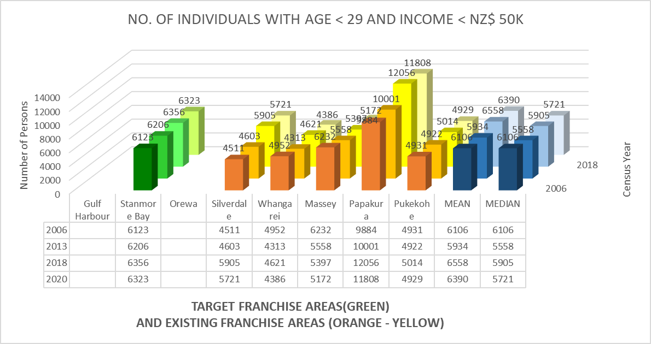
STANMORE BAY: EFFECT OF GEOGRAPHY
This is shown to increase the target demographics of Stanmore Bay to exceed the median of comparable target markets.
Mapdata at 2020 by Google
Photo by Tatiana Syrikova from Pexels

Slide 19
GULF HARBOUR: EFFECT OF GEOGRAPHY
Orewa
Gulf Harbour
Stanmore Bay
Silverdale
If Gulf Harbour is the selected area, the target demographics at Stanmore Bay is expected to patronize Gulf Harbour due to proximity. Those at Orewa will continue to patronize the outlet at Silverdale.
Mapdata at 2020 by Google
Photo by Tatiana Syrikova from Pexels

Slide 20
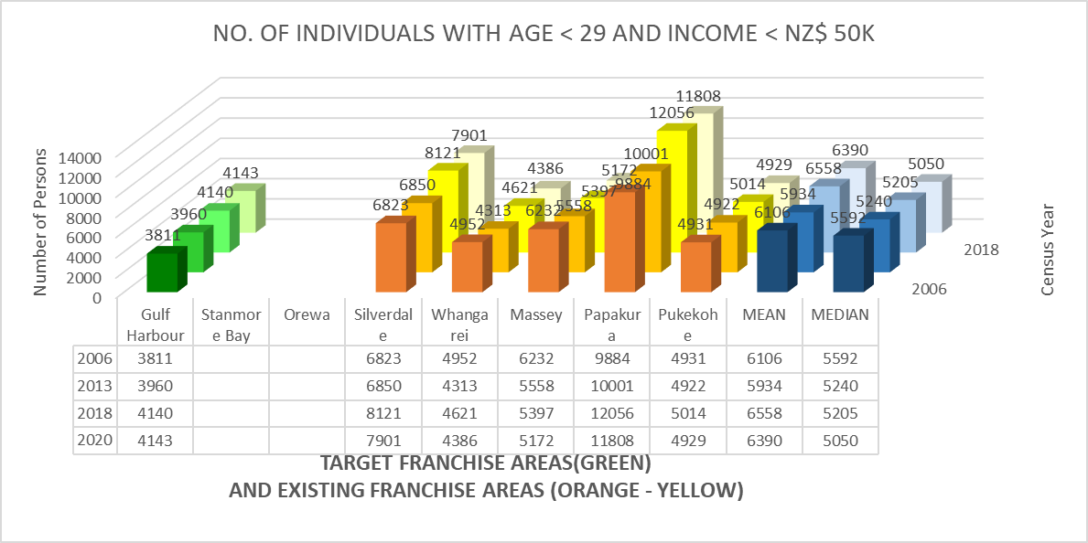
GULF HARBOUR: EFFECT OF GEOGRAPHY
This is shown to increase the target demographics of Gulf Harbour but this is still less than the median of comparable target markets.
Photo by Tatiana Syrikova from Pexels

Slide 21

DISTRICT COMPETITIVE ADVANTAGE
The accommodation and Food Services Location Quotient of Hibiscus Coast District is greater than comparable markets as well as Auckland in general.
Photo by Andrea Piacquadio from Pexels

Slide 22
DISTRICT COMPETITIVE ADVANTAGE
Photo by Andrea Piacquadio from Pexels

Slide 23
SELECTED SUBURB
STANMORE BAY
Draws the most target demographics among the three target areas.
The size of its target demographics is greater than the median of comparable existing markets in Auckland.
Food services industry at Hibiscus Coast is more advantageous than those of most comparable markets in Auckland
Food services industry as a percent of GDP is greater at Hibiscus Coast than those of most comparable markets in Auckland.
Photo by Andrea Piacquadio from Pexels

Slide 24

STANMORE BAY: OUTLET LOCATION SELECTION
List comes from Hibiscus Coast lease advertisements.
Photo by Taryn Elliott from Pexels

Slide 25
OUTLET LOCATION SELECTION SHORTLIST
STANMORE BAY SHORTLIST
5A/667 Whangaparaoa Road, Whangaparaoa
719 Whangaparaoa Road, Stanmore Bay
7/15 Karepiro Drive, Stanmore Bay
Three are shortlisted because they are classified as a food service facility and are large enough to accommodate customers in the area.
Photo by Taryn Elliott from Pexels

Slide 26
EVALUATING SHORTLISTED LOCATIONS
SELECTION CRITERIA
SECURITY
VISIBILITY AND ACCESSIBILITY
PARKING
COMPETITION
Photo by Taryn Elliott from Pexels

Slide 27
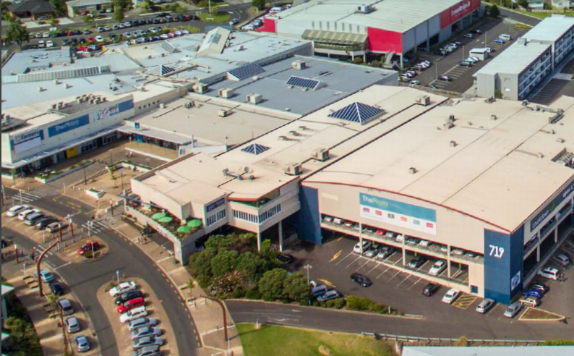
OPTION 1: 719 Whangaparaoa Road, Stanmore Bay, Auckland
Photo from https://www.aucklandcouncil.govt.nz/about-auckland-council/how-auckland-council-works/local-boards/all-local-boards/hibiscus-bays-local-board/Documents/whangaparaoa-centre-plan-december-2018.pdf
Photo by Taryn Elliott from Pexels

Slide 28
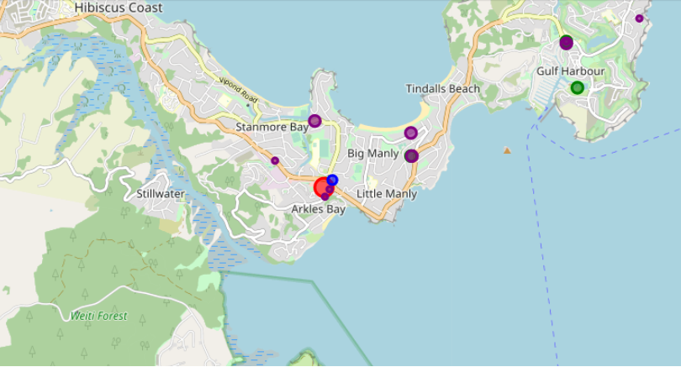
OPTION 1: 719 Whangaparaoa Road, Stanmore Bay, Auckland
Target Location
Police
Market
Restaurant
Fast Food
Photo by Taryn Elliott from Pexels

Slide 29
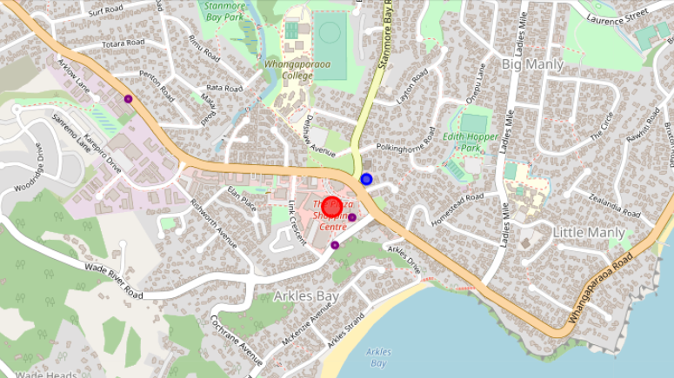
OPTION 1: 719 Whangaparaoa Road, Stanmore Bay, Auckland
Target Location
Police
Market
Restaurant
Fast Food
Photo by Taryn Elliott from Pexels

Slide 30
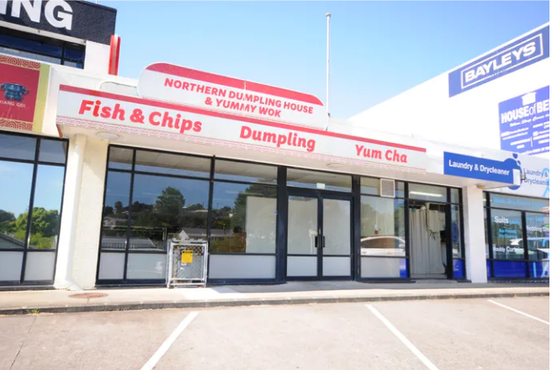
OPTION 2: 5A/667 Whangaparaoa Road, Whangaparaoa, Auckland
Photo and adverts from https://www.realestate.co.nz/3733424/commercial/lease/5-a667-whangaparaoa-road-whangaparaoa
Photo by Taryn Elliott from Pexels

Slide 31
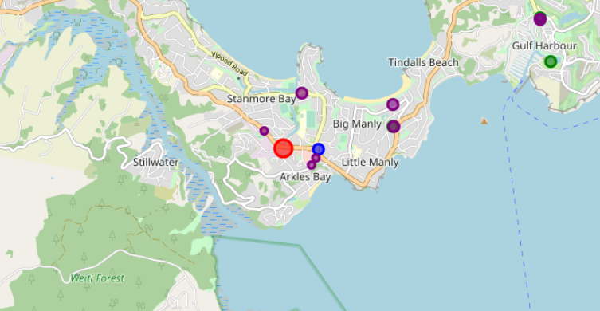
OPTION 2: 5A/667 Whangaparaoa Road, Whangaparaoa, Auckland
Target Location
Police
Market
Restaurant
Fast Food
Photo by Taryn Elliott from Pexels

Slide 32
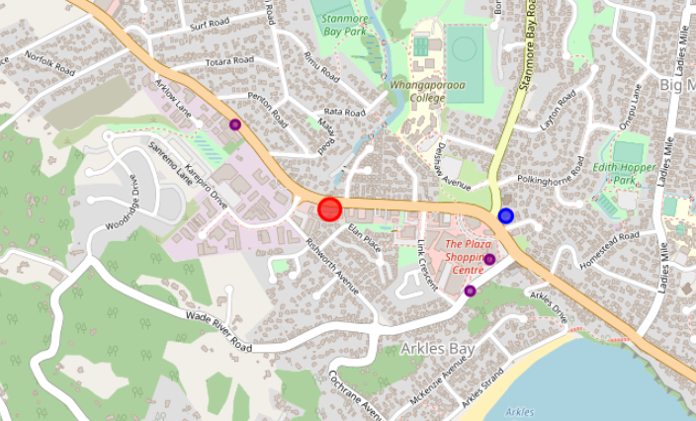
OPTION 2: 5A/667 Whangaparaoa Road, Whangaparaoa, Auckland
Target Location
Police
Market
Restaurant
Fast Food
Photo by Taryn Elliott from Pexels

Slide 33
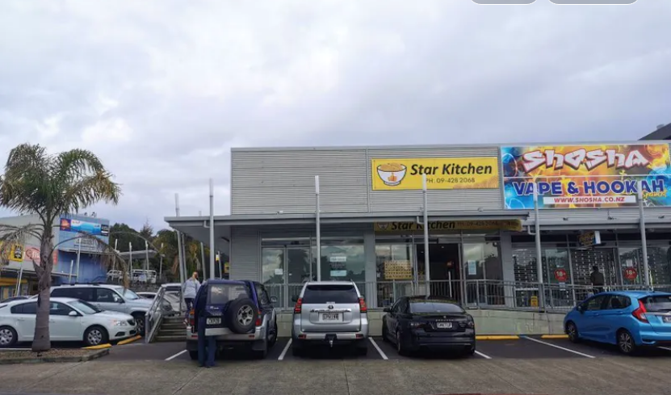
OPTION 3: 7/15 Karepiro Drive, Stanmore Bay, Auckland
Photo and adverts from https://www.realestate.co.nz/3825007/commercial/lease/715-karepiro-drive-stanmore-bay
Photo by Taryn Elliott from Pexels

Slide 34
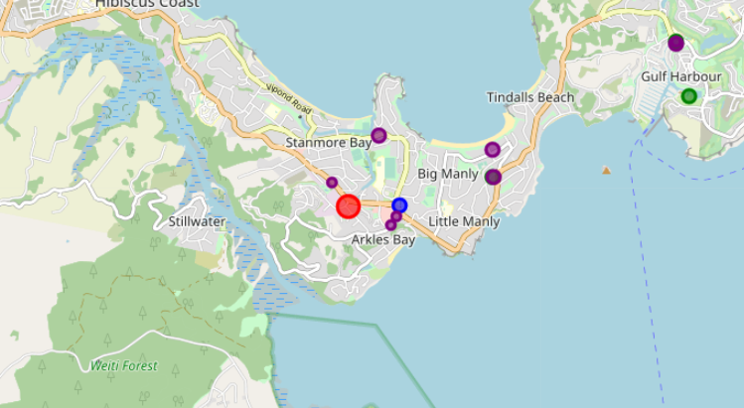
OPTION 3: 7/15 Karepiro Drive, Stanmore Bay, Auckland
Target Location
Police
Market
Restaurant
Fast Food
Photo by Taryn Elliott from Pexels

Slide 35
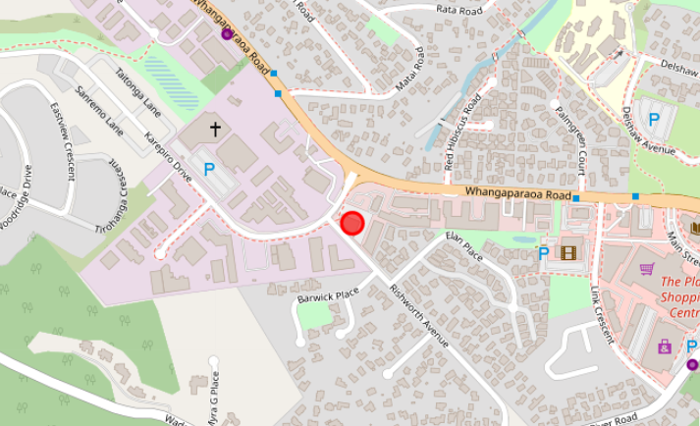
OPTION 3: 7/15 Karepiro Drive, Stanmore Bay, Auckland
Target Location
Police
Market
Restaurant
Fast Food
Photo by Taryn Elliott from Pexels

Slide 36
LOCATION EVALUATION AND COMPARISON
Photo by Taryn Elliott from Pexels

Slide 37
SELECTED LOCATION: 719 Whangaparaoa Road, Stanmore Bay, Auckland
Photo by Taryn Elliott from Pexels

Slide 38

Photo by Giftpundits.com from Pexels

